Slide 1
A Geovisual Framework with Open Data for Novice Users
Michael Crowder
Lauren Darr
Gerardo Garza
Brent Allan

Slide 2
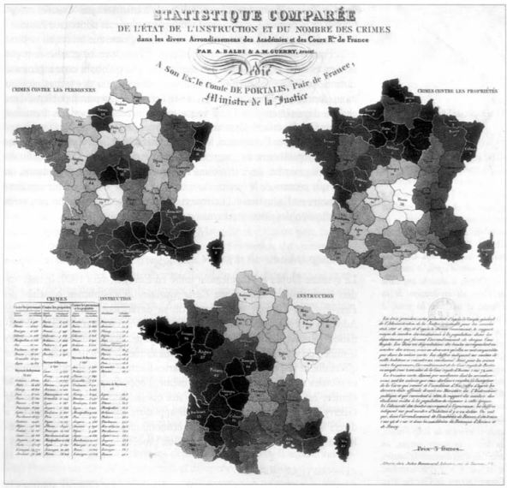
Crime Mapping
1830s Guerry maps crime rates and education in France
Birth of criminology and sociology
1990s crime mapping goes digital
Police adoption of digital maps remains complicated

Slide 3
Crime Mapping
Multi-purpose:
Shaping policy/strategy
Hot spot mapping
Crisis intervention
Public transparency and engagement
**Transition to open data somehow
Police User
Citizen User

Slide 4
Open Data
Open Data
Available and accessible
Re-use and redistribution
Universal participation
Task Force on 21st Century Policing
2015 Presidential agenda
“law enforcement community of practice”
>200 data sets released

Slide 5
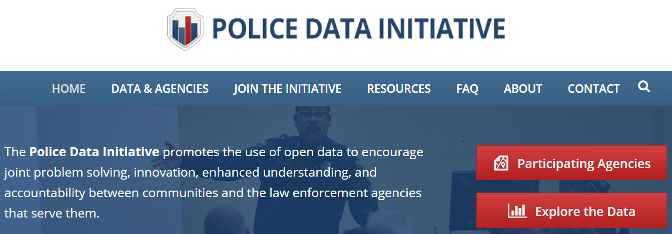
Open Data
Task Force on 21st Century Policing
2015 Presidential agenda
“law enforcement community of practice”
>200 data sets released

Slide 6
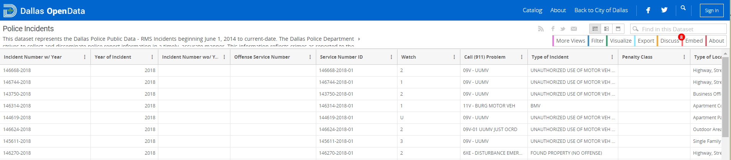
Open Data
Is open data really open at all?
Yes and No
Does the public know what or how to use:
Comma-separated values (.csv)
JavaScript Object Notation (JSON)
Application Programming Interface (API)
Does a giant data table engage the public?

Slide 7
Motivation
Two part:
New national standard for crime reporting: NIBRS
No current standards for geographical visualization of NIBRS data for the public

Slide 8
Motivation
Two phase motivation
National Incident-Based Reporting System (NIBRS)
New crime reporting standard starting in 2021
Allows up to 10 offenses per incident
Higher level detail on less serious crimes

Slide 9
Motivation
Two phase motivation
National Incident-Based Reporting System (NIBRS)
New crime reporting standard starting in 2021
Allows up to 10 offenses per incident
Higher level detail on less serious crimes

Slide 10
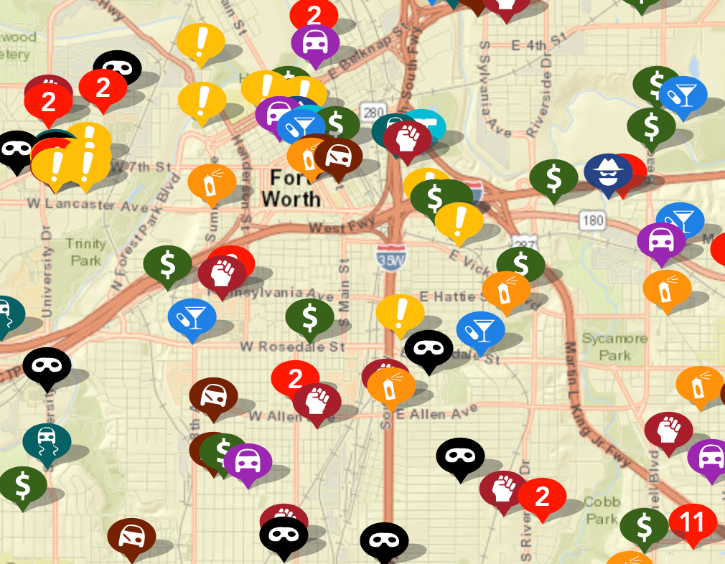
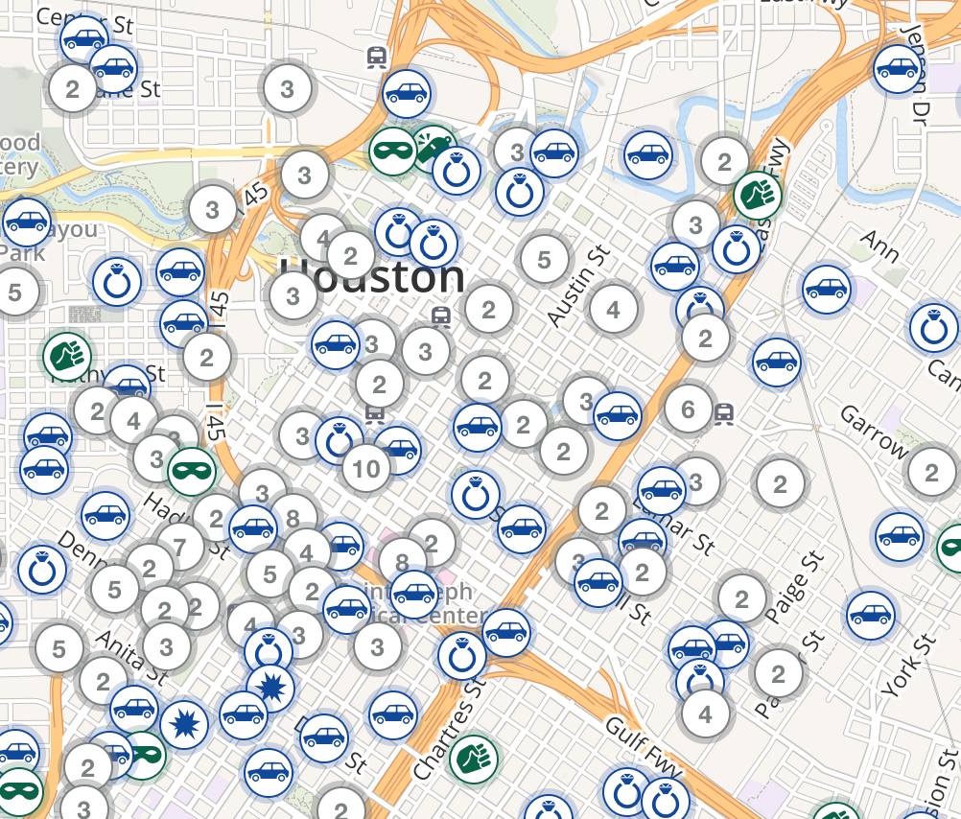
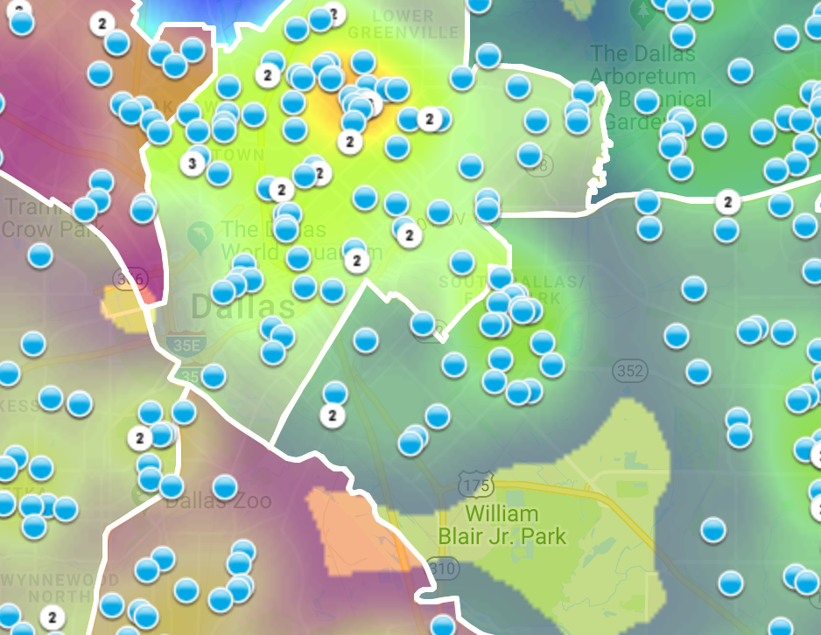
Motivation
Currently, no standards exist for geovisual framework to display criminal activity on digital maps.
https://www.crimemapping.com/
https://www.crimereports.com
https:www.cityofirving.org

Slide 11
Data Source
Data source
City of Dallas Open Data Portal
Police Incident Data
386K Rows
103 Columns
2015 - 2018
Our mapping focuses on burglaries
Ability to segment
Not an overwhelming number like breaking into cars

Slide 12
Data Source
Data source
City of Dallas Open Data Portal
Police Incident Data
386K Rows
103 Columns
2015 - 2018
Our mapping focuses on burglaries
Ability to segment
Not an overwhelming number like breaking into cars

Slide 13
Map Making
Mapping handled through open-source products
R
Leaflet – Open-source JavaScript library

Slide 14
Map Making
Mapping handled through open-source products
R
Leaflet – Open-source JavaScript library

Slide 15
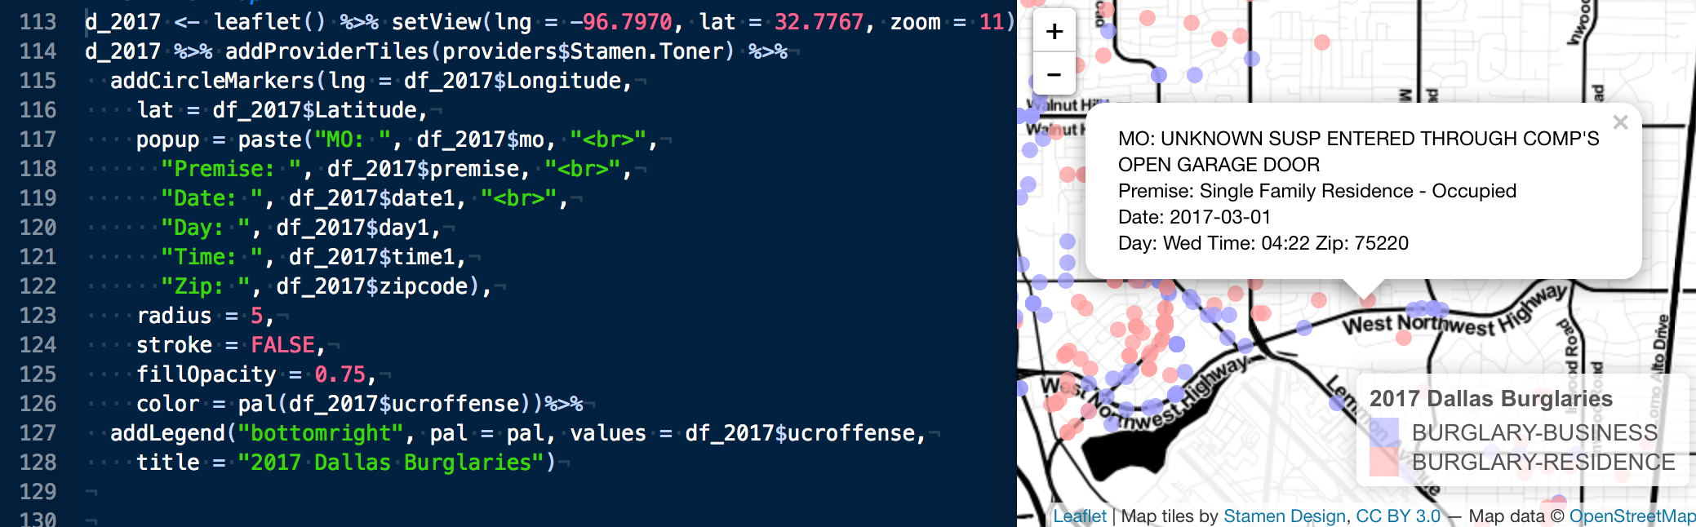
Map Making
Mapping handled through open-source products
R
Leaflet – Open-source JavaScript library

Slide 16
Intro to framework
Law Enforcement Agencies
On Average employ 68 people
31% are civilians
That’s around 20 people to run

Slide 17
Intro to framework
Law Enforcement Agencies
On Average employ 68 people
31% are civilians
That’s around 20 people to run
911 Operators
Dispatchers
Forensics
Mechanics
HR
Finance
https://www.bjs.gov/content/pub/pdf/lpd13ppp.pdf

Slide 18
Intro to framework
Law Enforcement Agencies
On Average employ 68 people
31% are civilians
That’s around 20 people to run
911 Operators
Dispatchers
Forensics
Mechanics
HR
Finance
https://www.bjs.gov/content/pub/pdf/lpd13ppp.pdf

Slide 19
Intro to Framework
Law Enforcement Agencies
On Average employ 68 people
31% are civilians
That’s around 20 people to run
911 Operators
Dispatchers
Forensics
Mechanics
HR
Finance
https://www.bjs.gov/content/pub/pdf/lpd13ppp.pdf

Slide 20
Geovisual Framework
Interactive
Time Bound
Contain variable(s)
Data Colors
Base Maps
Map Types

Slide 21
Geovisual Framework
Interactive
Time Bound
Contain variable(s)
Data Colors
Base Maps
Map Types

Slide 22
Interactivity
Cartographic Interaction
The use of a digital map by a user facilitated by a computer.

Slide 23
Interactivity
Interaction with maps allows users to explore scenes dynamically
Ability to vary scenes with changing scale and location spatially.
Enhanced user engagement leads to learning and understanding.

Slide 24
Interactivity
Interaction with maps allows users to explore scenes dynamically
Ability to vary scenes with changing scale and location spatially.
Enhanced user engagement leads to learning and understanding.
Use goes beyond crime mapping
Medical, engineering, biology, etc.

Slide 25
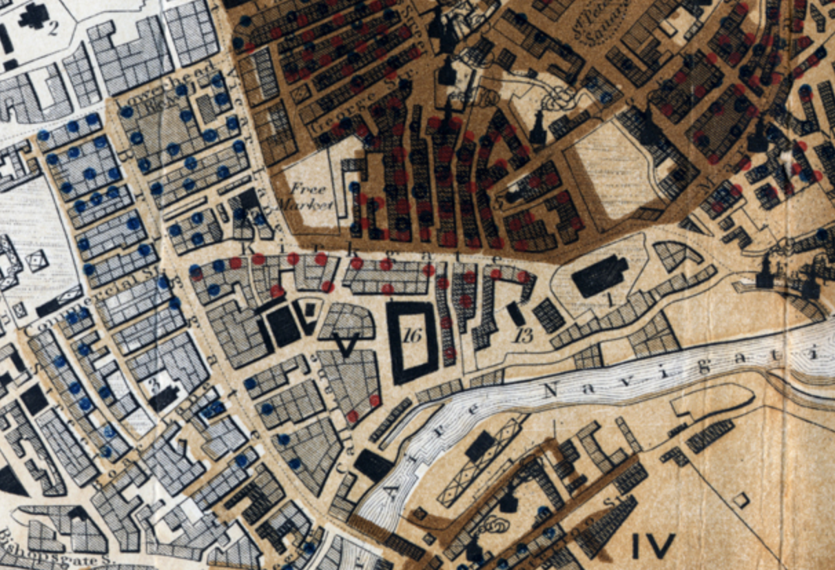
Color
The goal of color in a map is to give a clear visual indication of what is happening on the earth[x].
“Sanitary Map of the Town of Leeds” 1842
Blue dots are cholera
Orange dots are other contagious diseases

Slide 26
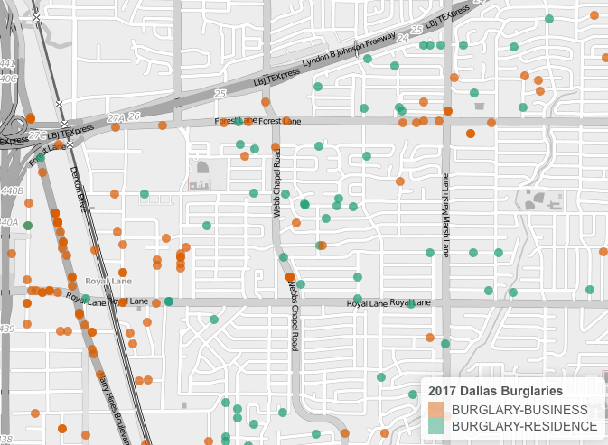
Color
Graphically showing the difference between entities by using color

Slide 27
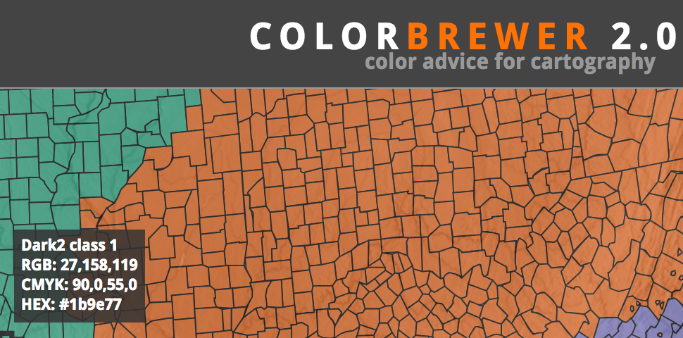
Color
Graphically showing the difference between entities by using color
Color Brewer[x]
Online tool for selecting color schemes for maps.

Slide 28
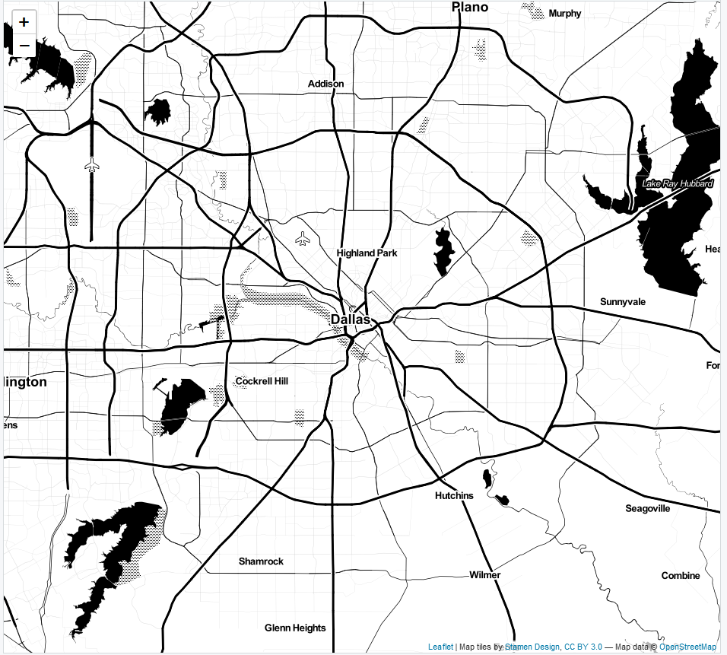
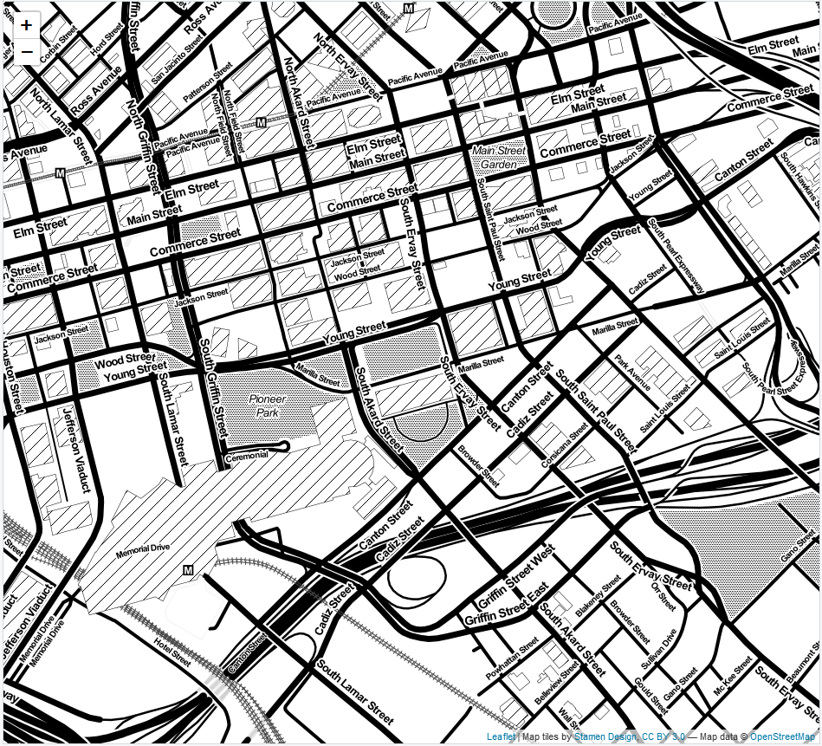
Basemaps
Zoom: ‘11’
Zoom: ‘16’
Leaflet, 3rd party, or custom map tiles
Landscape of chosen design and detail
Layering capability
2-lines of code

Slide 29
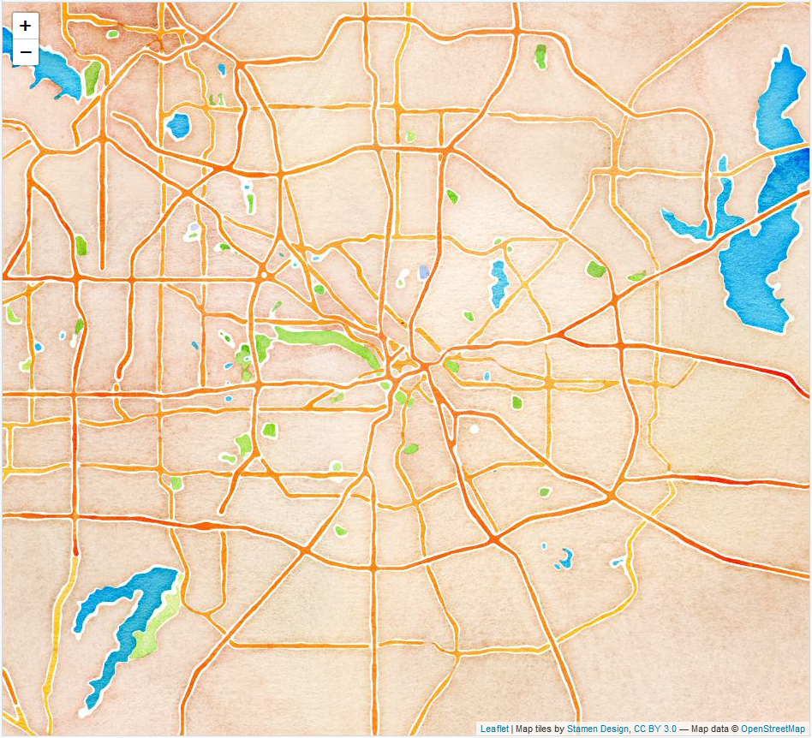
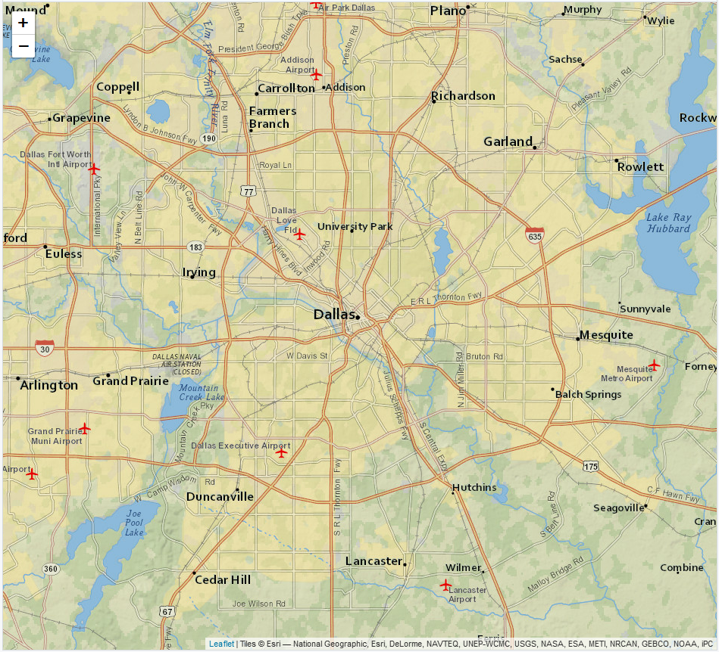
Basemaps
Artistry v. Clarity
Watercolor
Zoom: ‘11’
NatGeo
Zoom: ‘11’

Slide 30
Map Types
Dot Map
Discrete, multiple variables
View of landscape
Dot size can be misleading
Opacity for density
*Map examples*

Slide 31
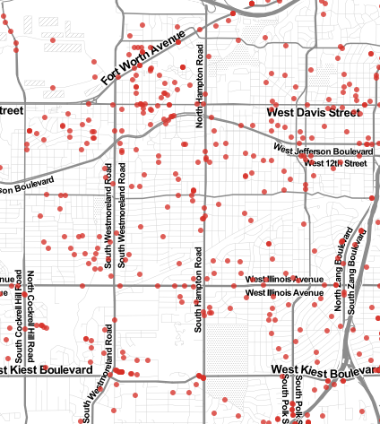
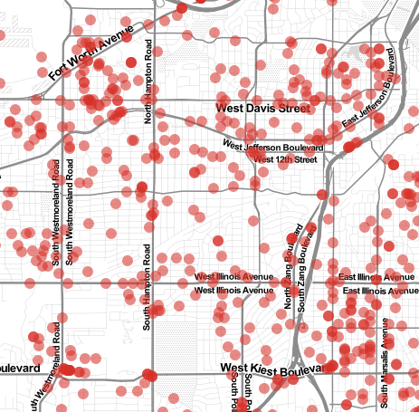
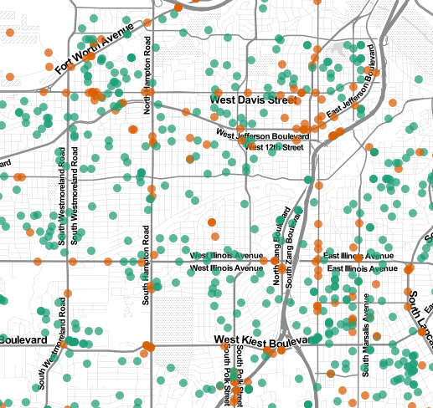
Map Types
Dot Maps at the same scale different dots
Small Dots
Large Transparent Dots
Multiple Variables

Slide 32
Map Types
Cluster Map
Solution to densely populated dot map
Mouse over feature
‘Spiderfy’ shows individual objects on zoom
Computationally more efficient than dot

Slide 33
Map Types
Cluster Map
*Map examples

Slide 34
Map Types
Heat Map
Density, higher level view
Heat v. Hot Spot important distinction
Single variables

Slide 35
Map Types
Heat Map
*Map examples

Slide 36
Variable Selection
# NIBRS Incident types
Can’t display all variables at once
What are most useful for citizens?
Careful to choose several together

Slide 37
Variable Selection
*Examples

Slide 38
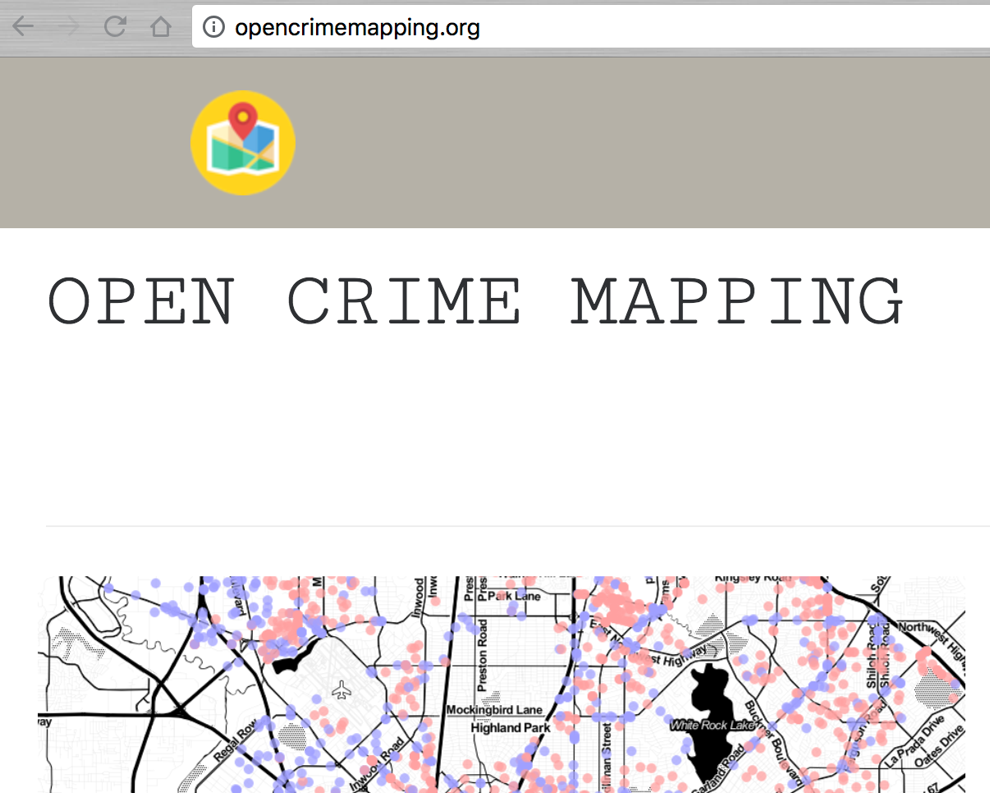
Deployment & Conclusion
Website!!!!!!!!!

Slide 39
Deployment & Conclusion

Slide 40
Deployment & Conclusion

Slide 41
Deployment & Conclusion
Our framework sets out to guide smaller LEA’s in communicating to the citizen user with geovisualization
Time-bound
Limited variables
Well thought out colors
Right map for the right incident
Clean easy to read base maps
Interactive

